Slide 1
Environmental Impacts of Mining and Mineral Use

Slide 2
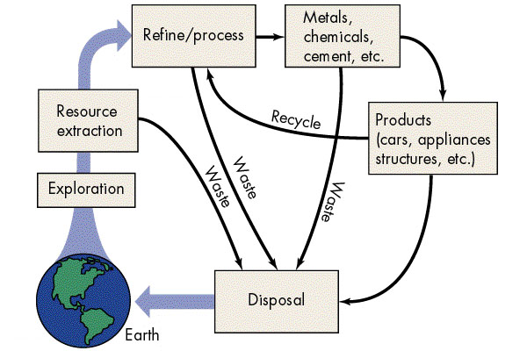

Slide 3
Reality of Mineral Use
The entire process of mining, smelting, and processing is a dirty process and we are sheltered from this process as much as possible
It is only the end product that is somewhat environmentally benign, till we throw it away.

Slide 4
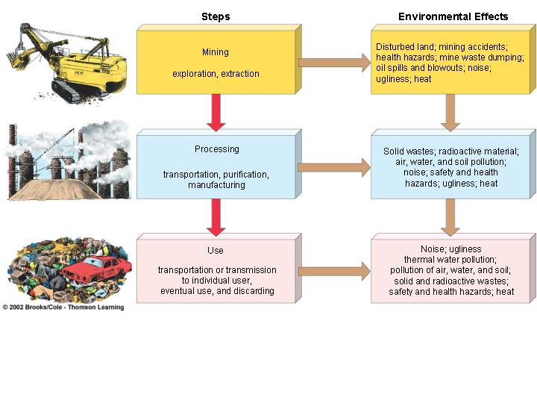
Environmental Impacts at every step of the mineral production-use cycle

Slide 5
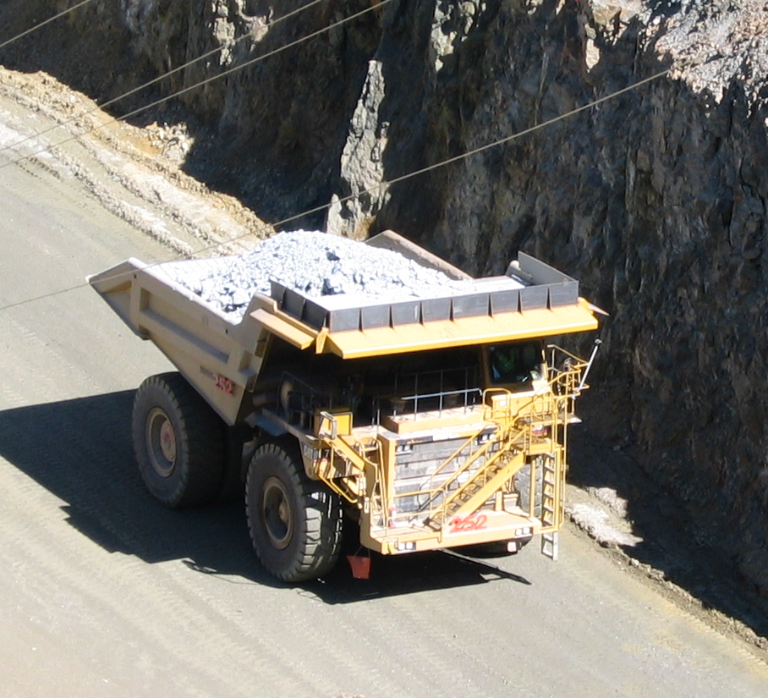
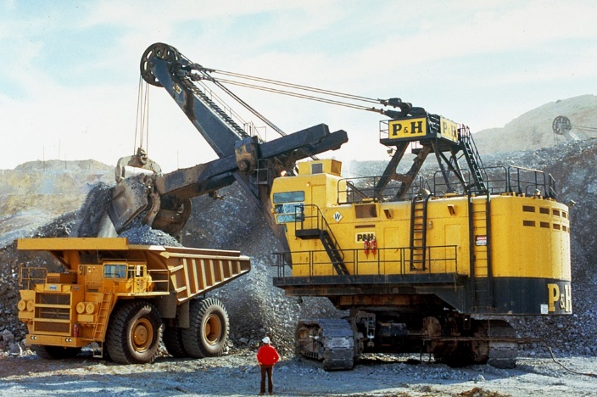
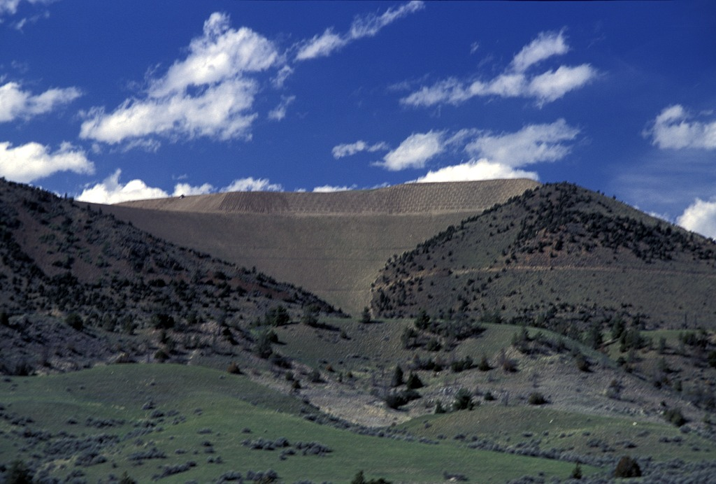
Extraction: Waste Rock
Waste rock is rock that has been broken up during mining but does not contain enough of the mineral resource to process the rock further.
non-ore containing rock (overburden)
rock that contains ore that is not concentrated enough to mine (below cutoff grade)
Waste Rock
(piled in between the hills)
Waste rock is usually deposited close to the mine to reduce hauling costs.
Waste piles can cover hundreds to thousands of acres and be over 100 feet high.
Waste rock filling in valley between mountains at Golden Sunlight Gold Mine, MT.
Notes:
Image Information Slide 17 Extraction: Waste Rock (I):
Huge Shovel: Credit: U.S. Bureau of Mines. “Huge electric shovels load broken material into trucks for transportation to crushing plants.” Image courtesy of the Earth Science World Image Bank, http://www.earthscienceworld.org/images. Reproduction under certain conditions is allowed for noncommercial use (http://www.earthscienceworld.org/images/imageuse.html).
Truck and Golden Sunlight Mine: Credit: Leah Joseph.
Waste Rock: Credit: Stuart Jennings, Montana State University. “Waste rock valley fill at the Golden Sunlight Mine.” Image courtesy of the Earth Science World Image Bank http://www.earthscienceworld.org/images. Reproduction under certain conditions is allowed for noncommercial use (http://www.earthscienceworld.org/images/imageuse.html).

Slide 6
Extraction: Waste Rock
Breaking up the ground surface (via blasting, digging, etc.) breaks the bedrock into smaller pieces.
This exposes more of a rock’s surfaces to the possibility of chemical weathering thus increasing the rate/amount of weathering and erosion.
For some mining wastes, this is not much of a problem.
Blasting!
Notes:
Image Information Slide 18 Extraction: Waste Rock (II):
Cubes: Sketched by Leah Joseph.
Mining Waste Pile: Credit: John Lucas/OLU (2006) “Mine waste tips at Cwmnewydion.” downloaded from: http://upload.wikimedia.org/wikipedia/commons/0/03/Mine_waste_tips_at_Cwmnewydion_-_geograph.org.uk_-_285920.jpg under a Creative Commons Attribution-Share Alike license (CC BY-SA 2.0 https://creativecommons.org/licenses/by-sa/2.0/).

Slide 7
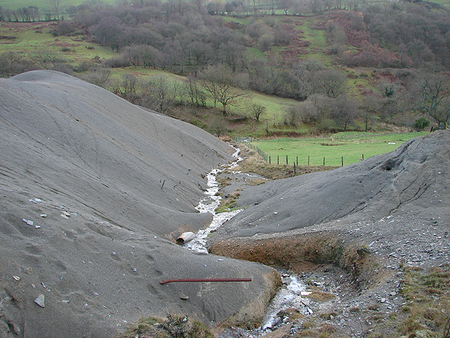
Extraction: Waste Rock
However, some waste rock contains metals or other undesirable chemicals that are mobilized when exposed to water, air, or other fluids.
→ These may be harmful to local organisms and/or may make the stream or groundwater acidic or contaminated (more on this later).
The United States is still dealing with hazardous waste rock from old “legacy” mines.
Today, there are often more careful placements and layering of waste materials in U.S. mines, so as to better avoid future problems with mine waste.
→ These include consideration of water flow trends and the establishment of monitoring procedures.
Mining waste pile.

Slide 8
List the Environmental hazards of waste rock
Notes:
Air pollution – dust blown from piles
Acid mine drainage from wasterock piles leaking – destroys aquatic life and pollutes groundwater
Physical space taken up by expansive waste piles
Often contains heavy metals (such as lead, mercury, cadmium) and other toxic metals (like arsenic)
Now lets talk more about acid mine drainage…

Slide 9
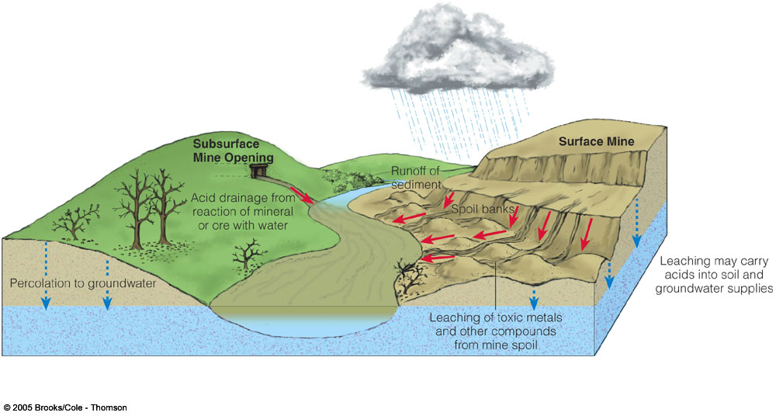

Slide 10
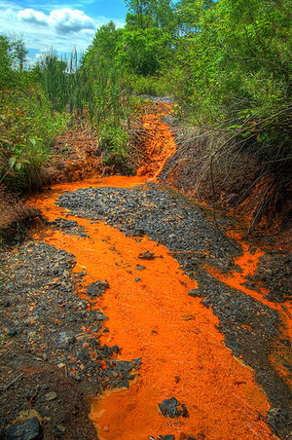
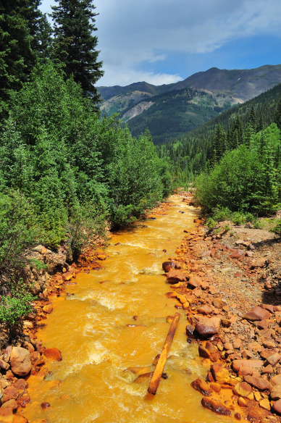
Mine Drainage
Water interacts with sulfide minerals in the mine and mine tailings.
Minimized by diversion techniques that prevent the water from interacting with the tailings.

Slide 11
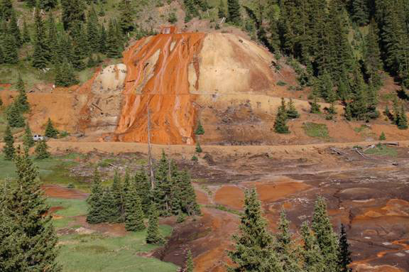
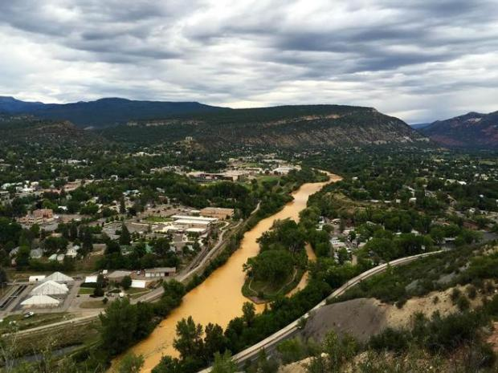
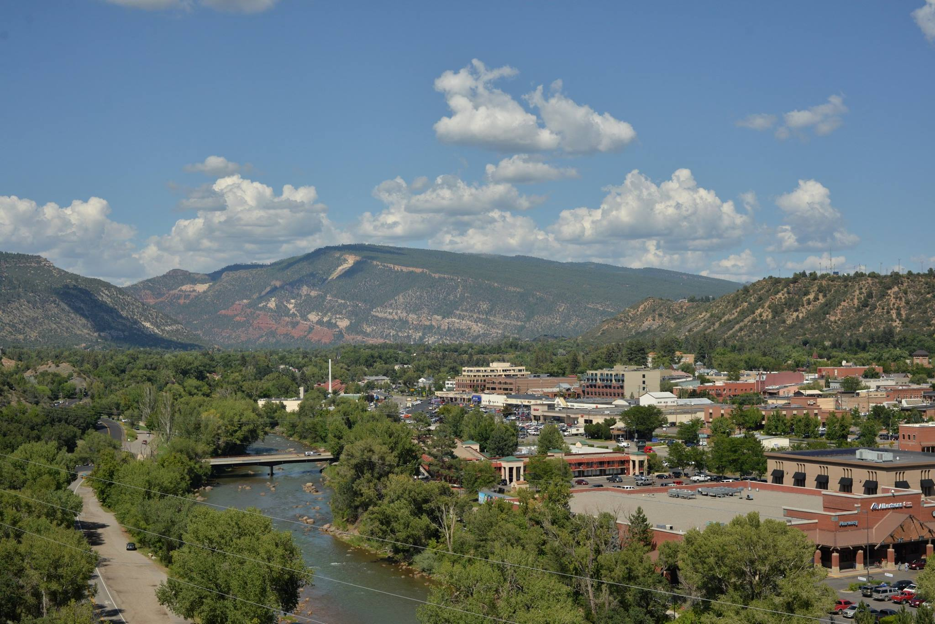
Mine Drainage
Catastrophic failures releasing large amounts of mine waters can occur
Animas River, Durango, CO, fouled by 1 million gallons of contaminated mine water, 2015

Slide 12
Influence of Climate
Climate is one of the major factors in determining how an area will recover over time
Rainfall and a moderate climate will greatly accelerate environmental restoration
BUT, mine runoff a bigger problem

Slide 13
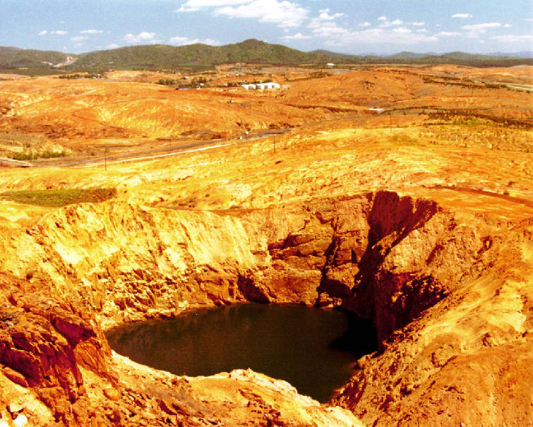
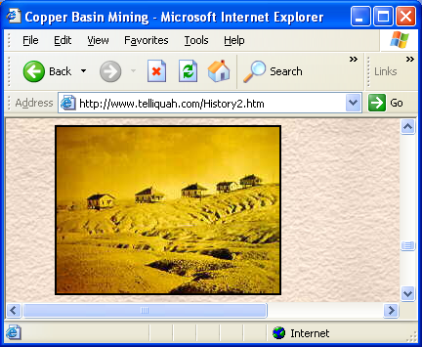
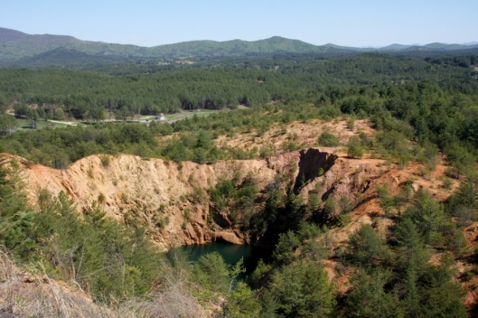
Copper Hill, TN
1970
1900
2007

Slide 14
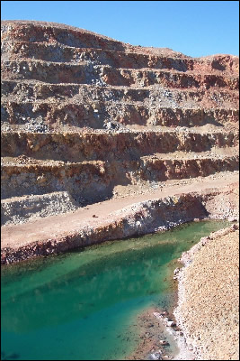
Mine sites out West
In arid areas, the mine runoff problem is not generally as big a problem as reclamation
The low rainfall discourages runoff and mine drainage, but it also prevents plants from re-establishing themselves.
Bottom Line: it takes a long time for the arid areas to recover
(This is the case for much of the western US)

Slide 15
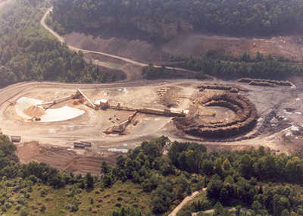
Mountaintop Removal Mining
MTRM operations are large surface mines
remove of rock layers to uncover coal beds so that they can be mined.
The excess material is placed in the steep heads of streams along the mountainside in areas called valley fills.
Notes:
The environmental, economic, and societal impacts of the surface mining practice in the Appalachians (MTRM) have attracted considerable attention.

Slide 16
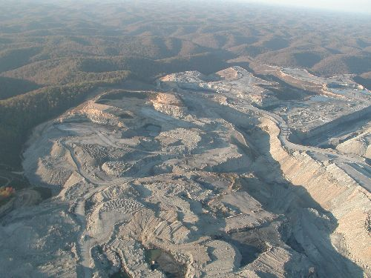
Streams are destroyed

Slide 17
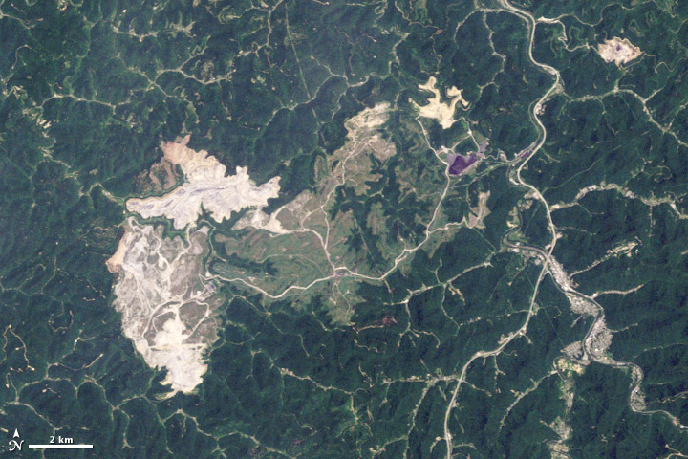
Hobet mine in West Virginia, 2009

Slide 18
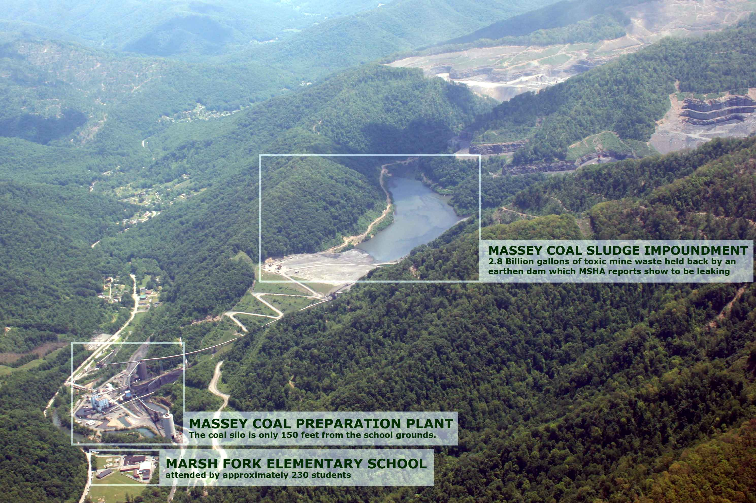
Coal Waste Dams

Slide 19
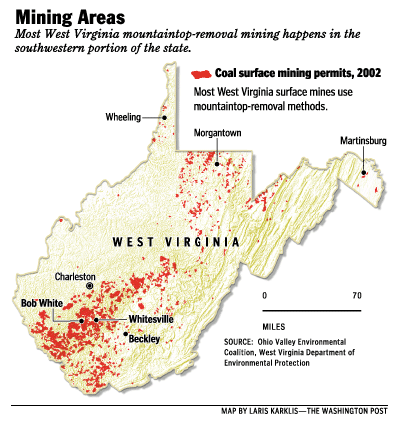

Slide 20
President G. W. Bush and MTRM
Before 2002, you were not allowed to dump waste rock from surface mining into streams.
In 2002, the Bush administration simply reclassified the debris from objectionable "waste" to legally acceptable "fill."
The fill rule is one of several key changes to coal-mining regulations that were enacted or proposed by the Bush administration, which promised to ease bureaucratic burdens for the coal industry and expand the nation's energy production.

Slide 21
More recently…
During the Obama Admin., the Dept. of Interior Office of Surface Mining (OSM) commissioned independent research into health effects of MTRM
Trump admin. halted activity on research grants >$100,000 in Aug 2017 and proposed a budget cut for OSM of 49%
Notes:
After several scientific studies linked MTRM to increased lung, kidney disease, elevated mortality rates and elevated birth defects, ~1 Million in research grants were awarded over 2 years to delve deeper into potential health effects on nearby communities.

Slide 22
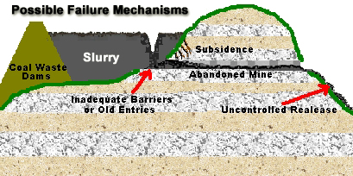
Failure Mechanisms

Slide 23
Surface Mining Control and Reclamation Act
Established 1977
Mine lands must be restored to pre-mining conditions
There are taxes on mining companies to restore pre-1977 sites
Limited success

Slide 24
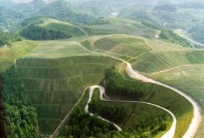
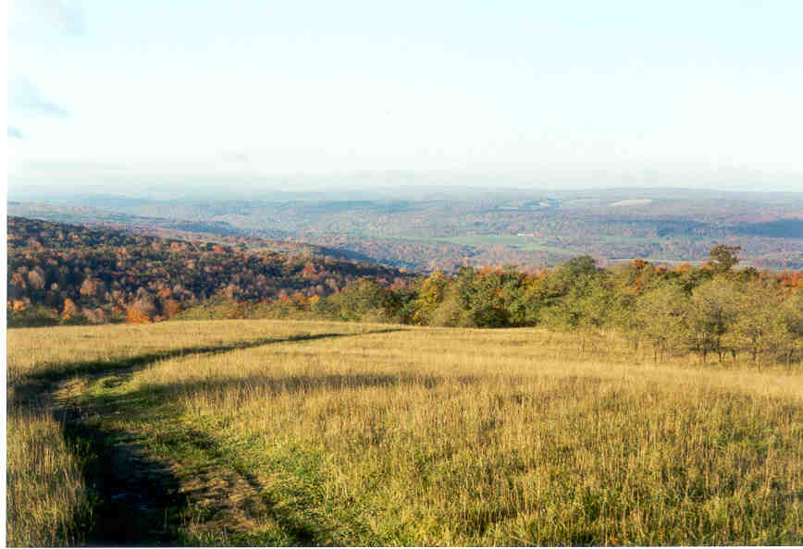
Reclaimed Strip Mines
The bright side:
Topsoil that has been stored can be returned
Flat benches = good meadows for cattle

Slide 25
Other mine reclamation concepts
Reclamation of open pit mines is much harder
What do you do with an enormous hole in the ground?
Fills with groundwater – if sulfides present, makes for a very nasty acidic lake
Underground mines can be fairly easily blocked off
Generally fill with groundwater (risk of acid mine drainage though – e.g. Gold King Mine example, CO)
Gravel pits and quarries (no sulfides present) can be turned into recreational lakes
Notes:
Some successful reclamation stories: https://mineralseducationcoalition.org/mining-minerals-information/reclamation-stories/

Slide 26
List some Underground Mining Problems
Notes:
Subsidence – can be really bad when under towns and roads
Small earthquakes
Collapse/fires –coal mines burning – CO2 releases
Acid mine drainage – water exposed to sulfide minerals
Over 10,00 miles of streams have been adversely impacted by acid mine runoff

Slide 27
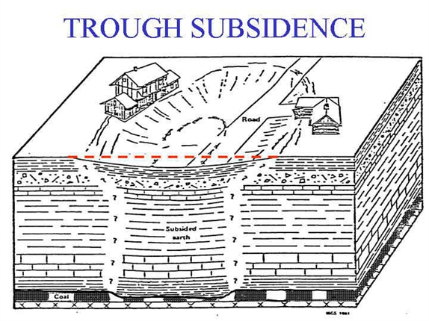
Land Subsidence
Mine subsidence is the settlement of the ground surface following the extraction of an underground ore body.
Mine subsidence has the potential to damage buildings, infrastructure, and utilities such as pipelines.
The extent of subsidence is related to rock quality, overlying strata, depth , areal extent, and time.

Slide 28
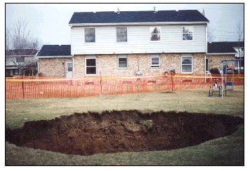
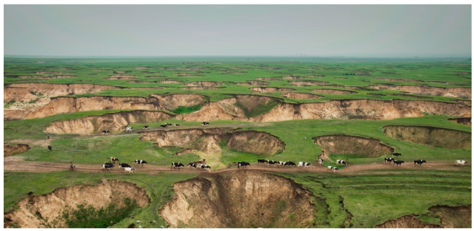
Land subsidence from Mines

Slide 29
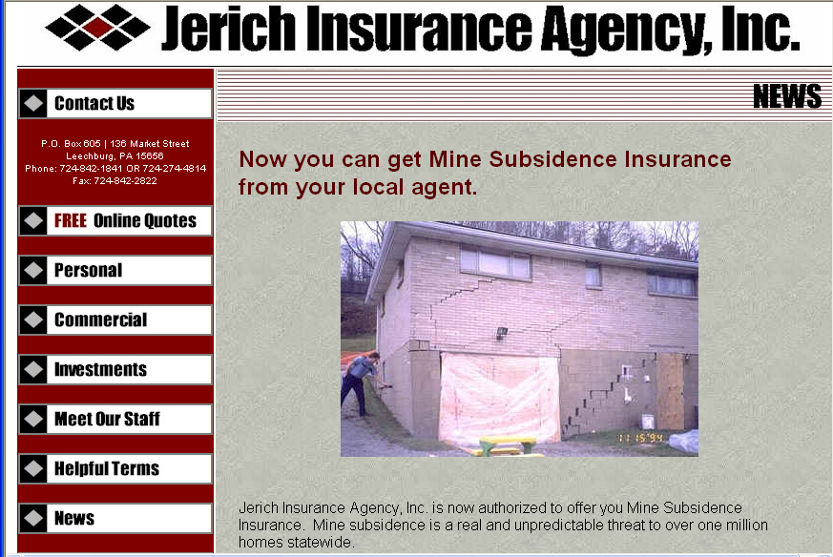
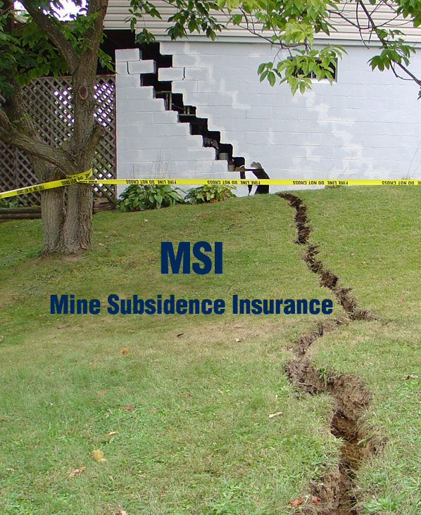
If you move to Pennsylvania,

Slide 30
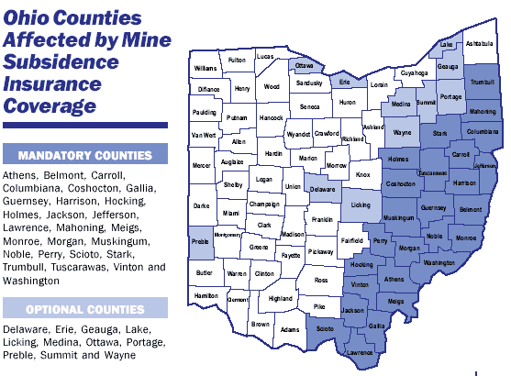
Or Ohio….

Slide 31
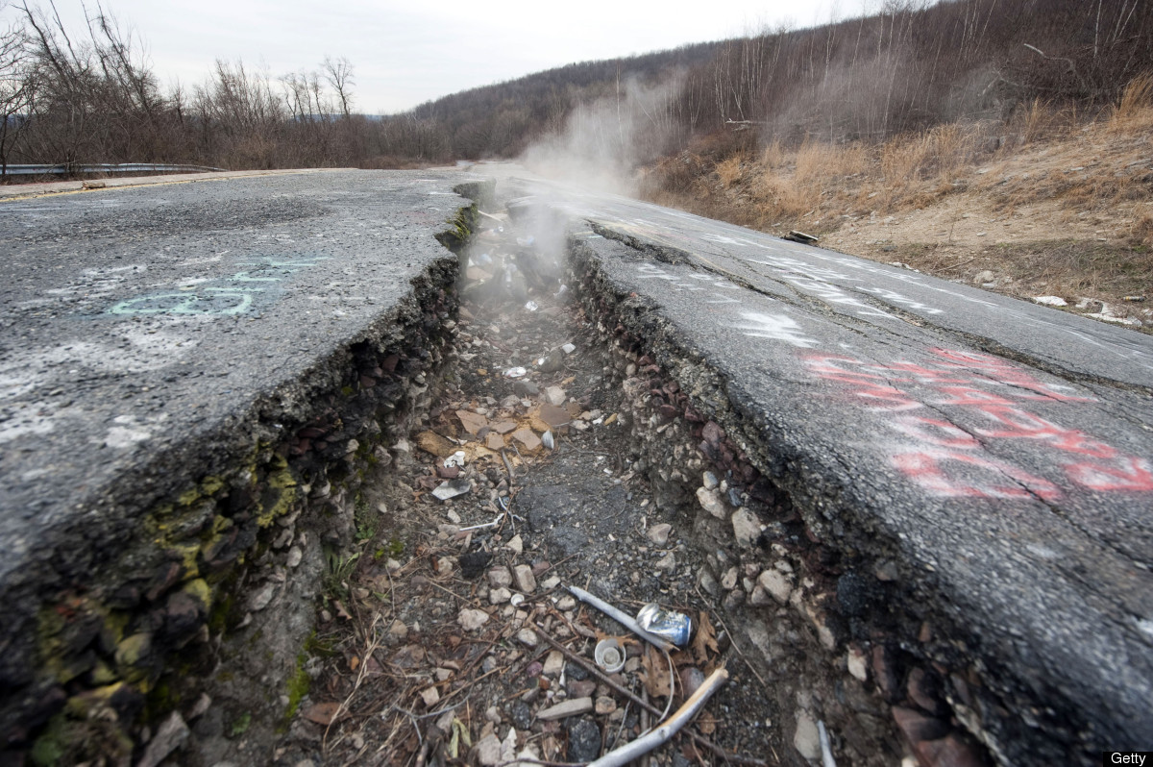
Coal mine fires: e.g. Centralia, Pa.
A fire started in the town dump in 1961 due to burning garbage
The fire spread into an old coal mine that lies underneath the town
Town is now mostly deserted
Toxic fumes and holes open up
The fire may burn for a thousand years, may spread to nearby towns.
Fire started in 1962

Slide 32
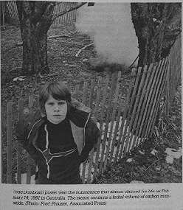
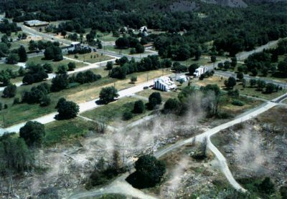
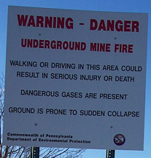
Notes:
In 1981, kid fell into sinkhole in his backyard with lethal levels of CO gas and hot steam.
Ground temperature in some places is hot enough that if you place a match on the ground, it will ignite.
Has enough fuel to burn for 1000 years

Slide 33
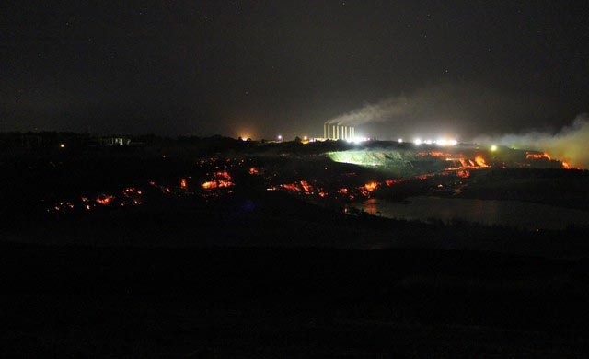
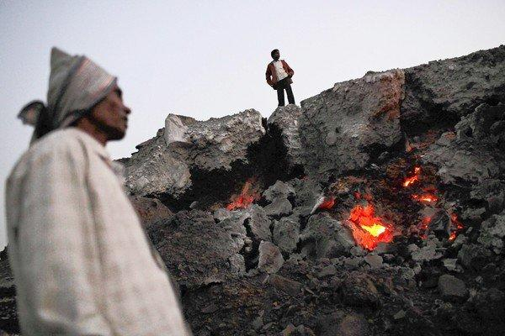
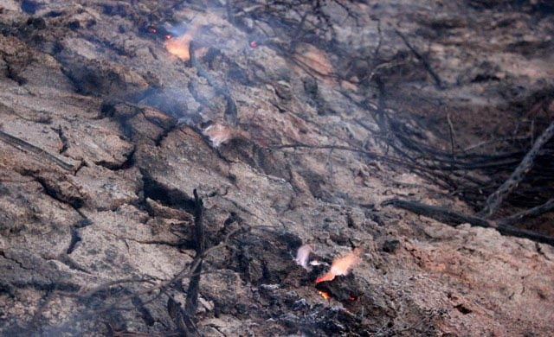
Coal Fire vent
Jharia coal fire, India
Morwell Coal fire, Australia

Slide 34
Reality of Mineral Use
Bottom Line: Are we paying the true cost of mineral resources?
What about minerals taken from government land at little cost with environmental degradation at every step?

Slide 35
In the US,
Mining companies get:
depletion allowances – so they pay less taxes
use government land and pay no royalties
Justification - mineral prospecting is expensive and mineral development is very expensive and risky

Slide 36
General Mining Law of 1872
Governs mining on federal lands
Concerns only hardrock minerals – ie, gold silver, iron, copper, lead, etc. – not coal
Just need to spend $500/yr to keep claim valid
Don’t pay royalties to the government for minerals they take off these lands

Slide 37
Legacy of Mining in the West on Public Lands
There are 55,000 abandoned hardrock mines in the West on public lands alone that will cost 50 billion dollars to clean up
Many companies have taken all the minerals and then declared bankruptcy
In 1992, the law was amended to require mining companies to post 100% of the cleanup costs in case they go bankrupt

Slide 38
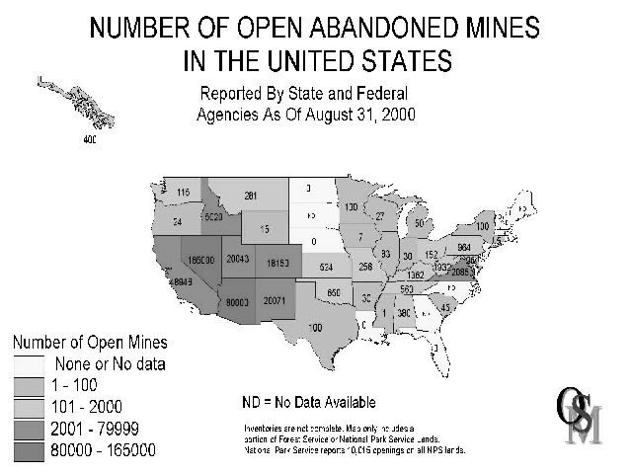
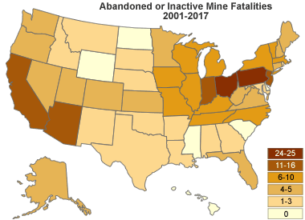
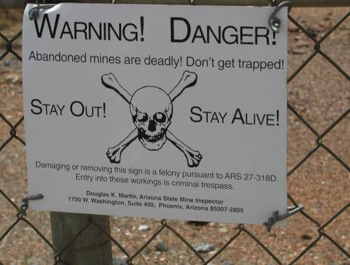

Slide 39
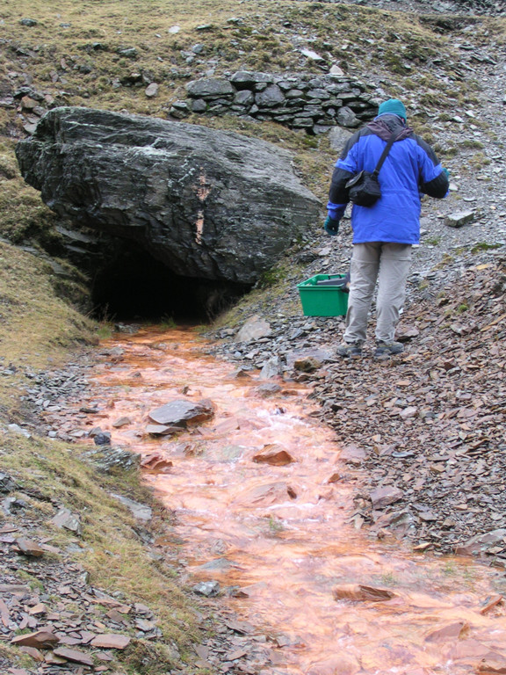
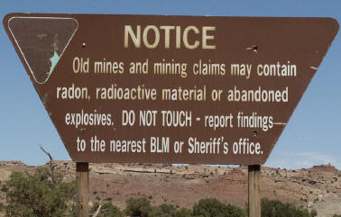
Continue to cause problems

